Slide 1
Uniswap AMM Teori !
Doç. Dr. VeriDelisi

Slide 2
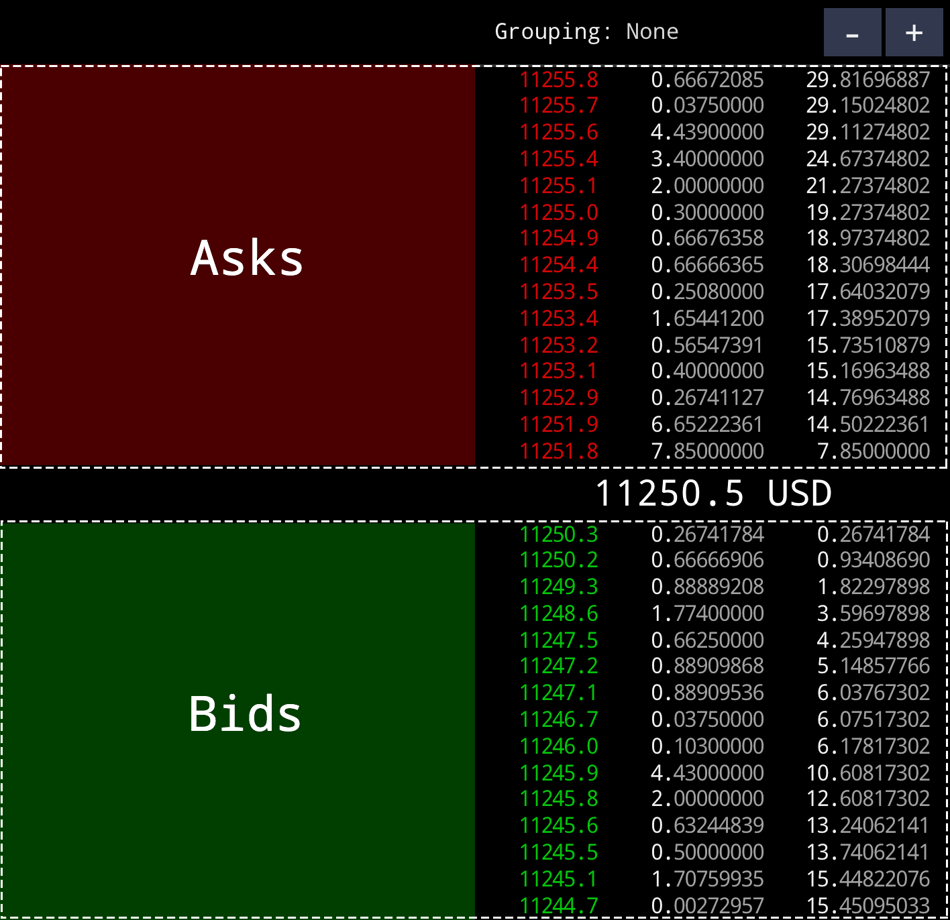
Order Book
This is actual price !

Slide 3
Order Book

Slide 4
The Constant Product AMM
This is an algorithm for trading two fungible tokens, α and β.
Let x be the liquidity pool reserves of α and y and the reserves of β.
The market has reserves x > 0 and y > 0
constant product x * y = L²

Slide 5
The Constant Product AMM
The market has reserves x > 0 and y > 0
constant product x * y = L²
Consider the case where one desires to sell Δx units of α in exchange for Δy units of β.
When the fee is 0,

Slide 6
The Constant Product AMM
Consider the case where one desires to sell Δx units of α in exchange for Δy units of β.
When the fee is 0,
The name constant product market comes from the fact that any trade Δx to Δy must change the reserves in such a way that the product of x and y remains equal to the constant L².

Slide 7
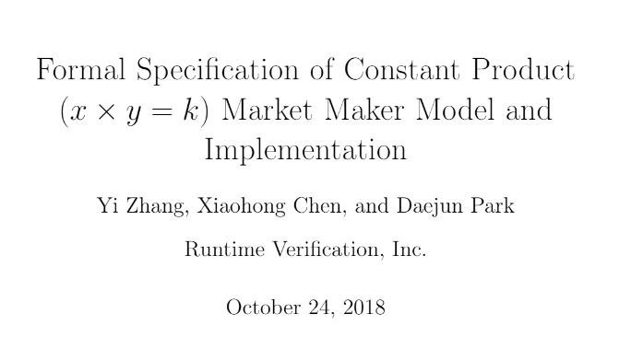
The Constant Product AMM
https://github.com/runtimeverification/verified-smart-contracts/blob/master/uniswap/x-y-k.pdf

Slide 8
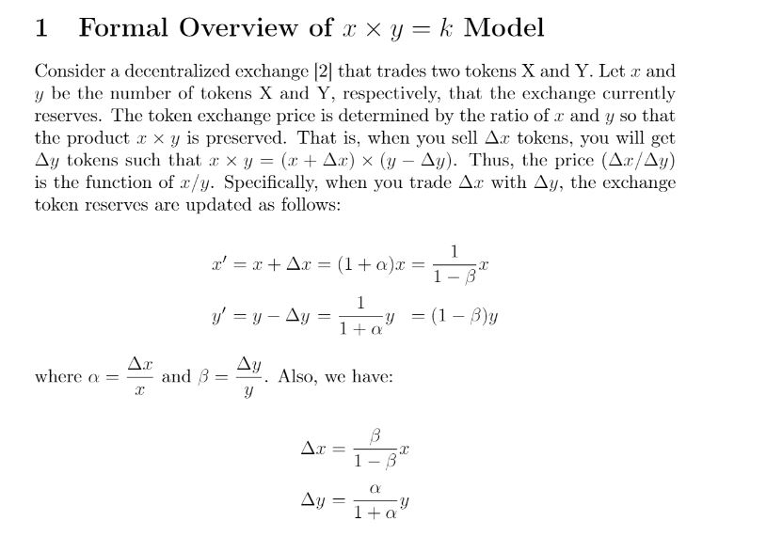
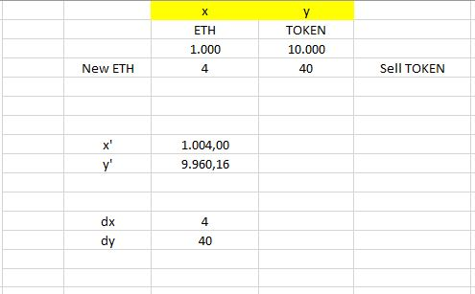
The Constant Product AMM
https://github.com/runtimeverification/verified-smart-contracts/blob/master/uniswap/x-y-k.pdf

Slide 9
The Constant Product AMM
Fee===%0.3
0.997
(x+rΔx)(y−Δy)=x * y
https://github.com/runtimeverification/verified-smart-contracts/blob/master/uniswap/x-y-k.pdf

Slide 10
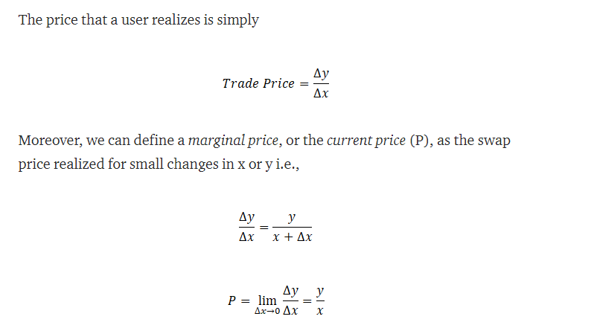
The Price
https://github.com/runtimeverification/verified-smart-contracts/blob/master/uniswap/x-y-k.pdf

Slide 11
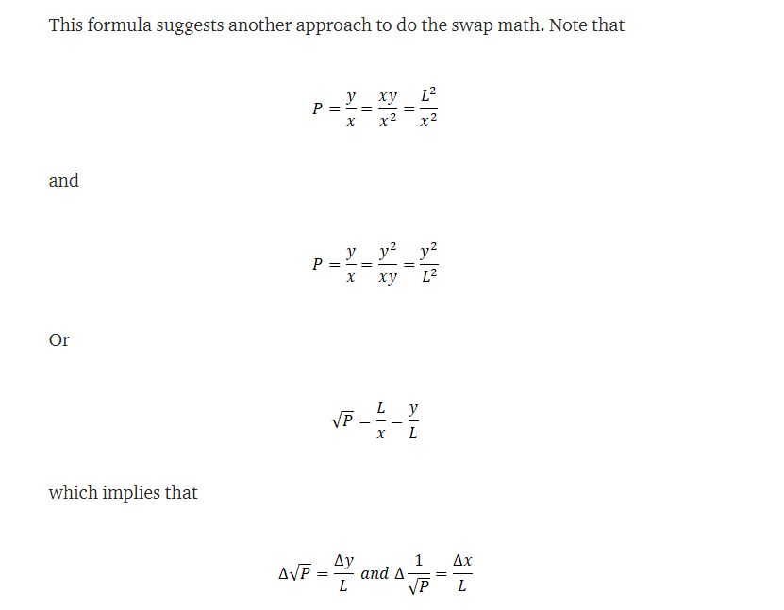
The Price
https://github.com/runtimeverification/verified-smart-contracts/blob/master/uniswap/x-y-k.pdf

Slide 12
DAI-ETH Pair
https://etherscan.io/tx/0xe069b584e7e71a8390872b9b996fab2397a1b93e92e35cfa9e529be9db66adab/#eventlog

Slide 13
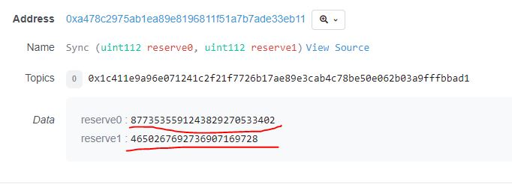
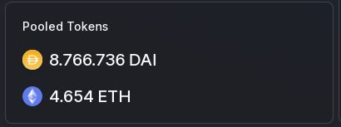
DAI-ETH Pair
https://etherscan.io/tx/0xe069b584e7e71a8390872b9b996fab2397a1b93e92e35cfa9e529be9db66adab/#eventlog

Slide 14
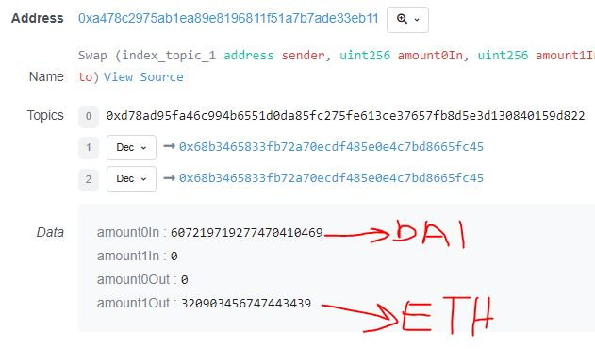
DAI-ETH Pair
https://etherscan.io/tx/0xe069b584e7e71a8390872b9b996fab2397a1b93e92e35cfa9e529be9db66adab/#eventlog

Slide 15
DAI-ETH Pair
uint amount0In = balance0 > _reserve0 - amount0Out ? balance0 - (_reserve0 - amount0Out) : 0;
True
https://etherscan.io/tx/0xe069b584e7e71a8390872b9b996fab2397a1b93e92e35cfa9e529be9db66adab/#eventlog

Slide 16
DAI-ETH Pair
uint amount0In = balance0 > _reserve0 - amount0Out ? balance0 - (_reserve0 - amount0Out) : 0;
Reserve0 :8.773.536
Balance0 :8.774.143
Amount0In:607
True
https://etherscan.io/tx/0xe069b584e7e71a8390872b9b996fab2397a1b93e92e35cfa9e529be9db66adab/#eventlog

Slide 17
DAI-ETH Pair
Amount0In:607
Amount1In:0
Fee
uint balance0Adjusted = balance0.mul(1000).sub(amount0In.mul(3));
uint balance1Adjusted = balance1.mul(1000).sub(amount1In.mul(3));
https://etherscan.io/tx/0xe069b584e7e71a8390872b9b996fab2397a1b93e92e35cfa9e529be9db66adab/#eventlog

Slide 18
Amount0In:607
Amount1In:0
DAI-ETH Pair
require(balance0Adjusted.mul(balance1Adjusted) >= uint(_reserve0).mul(_reserve1).mul(1000**2), 'UniswapV2: K');
https://etherscan.io/tx/0xe069b584e7e71a8390872b9b996fab2397a1b93e92e35cfa9e529be9db66adab/#eventlog

Slide 19
DAI-ETH Pair
https://etherscan.io/tx/0xe069b584e7e71a8390872b9b996fab2397a1b93e92e35cfa9e529be9db66adab/#eventlog

